Slide 1

VPL Framework
Group 9:
Dillon McGovern, David Wang,
Michael Gordon,Henry Smith,
and Dana Graham
Notes:
Dillon

Slide 2
Introduction
Visual Programming Language (VPL) - Allows users to create programs by manipulating program elements graphically rather than specifying them textually.
Tasked to design a VPL development framework
Identified similar functionality amongst existing VPLs
Notes:
Dillon
Describe idea behind a VPL
State what our project was and how we began brainstorming ideas

Slide 3
Research
VPL Similarities:
Graphical representation of a block
Relationship between blocks
Code representation of a block
Canvas
Mechanism to execute blocks
Display results of execution
Notes:
Dillon
Point out/describe the common points

Slide 4
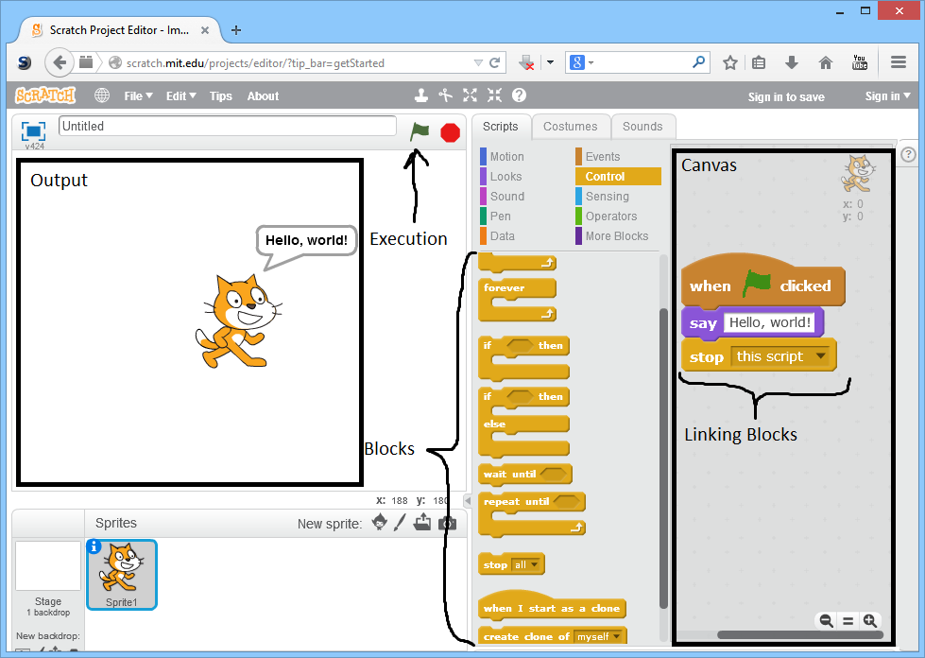
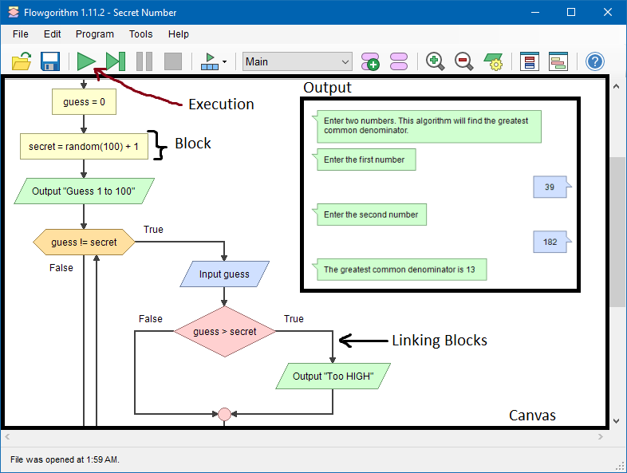
Research
Notes:
Dillon
Example

Slide 5
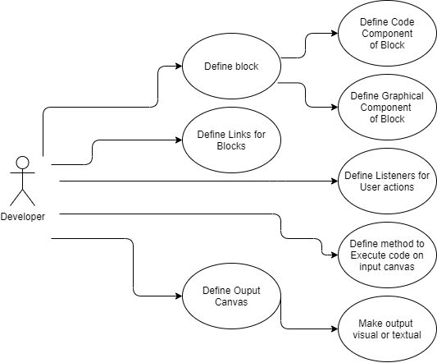
Features and Functionality
Block definition
Link blocks together
Canvas for drawing blocks
Canvas for displaying output
Notes:
Bid
we had to keep in mind that our framework is a framework for help developers to create vpls and not a framework of a specifc vpl
we started off with a use case diagram for a end user of a developed vpl and from there we could see what the developer needs to do
which is what we see here
So the developer needs to be able to define blocks
code component is what the code in the block will eventually compile into
graphical component is what will be shown on the screen on the canvas
also need to create links between the blocks
so going off what dillon said earlier
how scratch nests the blocks
and how flowgorithm links blocks with the arrows
also need to define user actions on the canvas
so clicking and dragging a block on the canvas, deleting a block, etc.
also need a way to execute the program on the canvas
so from placing blocks down to linking them the developer needs a way to execute the created program
and they need to cutomize the output canvas
so how to display the output from the program, whether that is textual like a console or display graphics of some kind

Slide 6
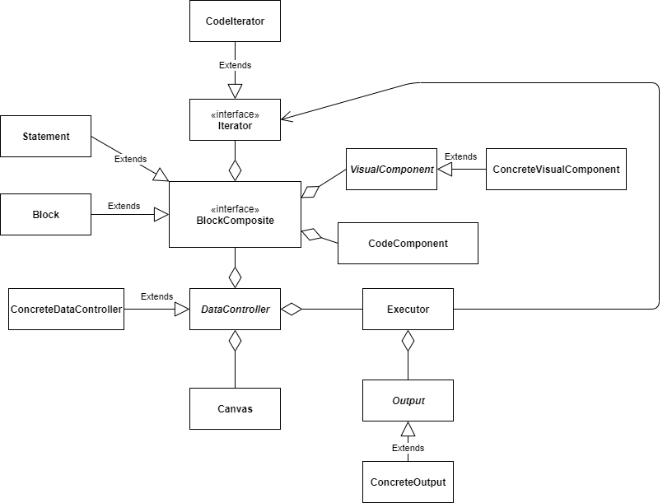
System Design
Notes:
Bid
Our framework has two general subsystems
MVC the model view controller sub system
where
BlockComposite - Model
DataController - Controller
Canvas - View
and deals with updating the user interface and then
Executor Output Subsys
which deals with compiling the program, running it, and displaying to an output

Slide 7
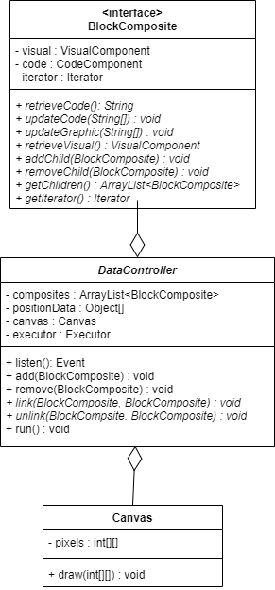
MVC Subsystem
Model: BlockComposite
View: Canvas
Controller: DataController
Notes:
Dillon

Slide 8
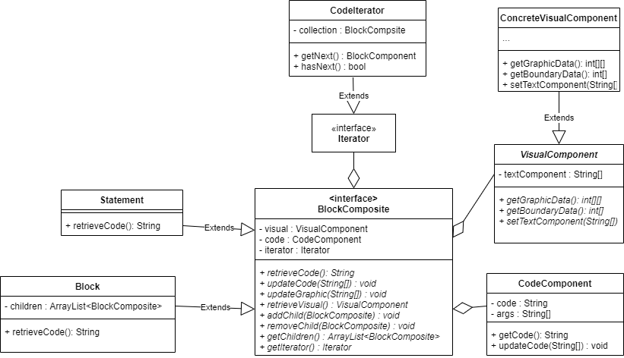
Model (BlockComposite)
Composite Pattern
Statement (Leaf Node)
Block (Container Node)
Code Component
Visual Component
Contains Iterator
Notes:
Dillon

Slide 9
VisualComponent
Allows developer to customize how they would like to graphically display blocks
Updated by the DataController
Notes:
Dillon

Slide 10
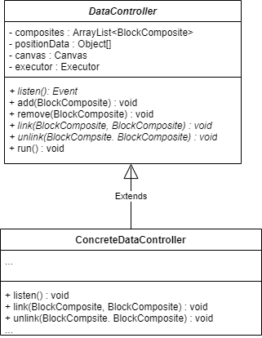
Controller (DataController)
Updates BlockComposite based on user interaction with Canvas
Manages position of blocks within BlockComposite
Notes:
Henry
Central part of design
Update Model, View
Has reference to composites, canvas, executor
Mention link, unlink, and listen()
Mention add, remove, and run()

Slide 11
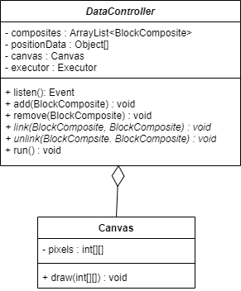
View (Canvas)
2D pixel array
Displays graphical information of the block
Updated by DataController
Notes:
Henry
Input Canvas
Single Responsibility

Slide 12
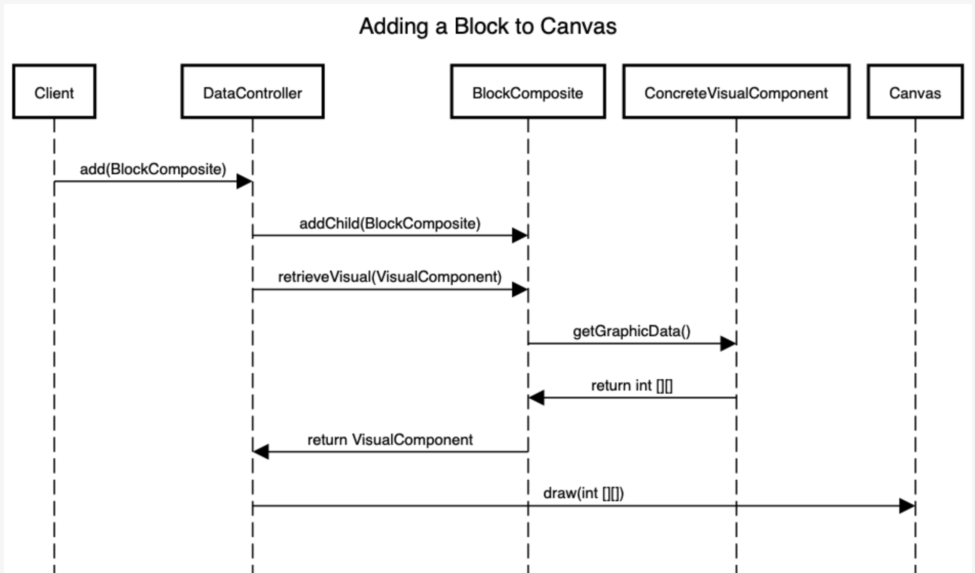
Sequence Diagram - Adding blocks using MVC system
Notes:
Henry

Slide 13
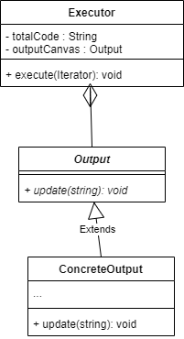
Executor
Utilizes Iterator pattern
Assembles code from BlockComposite
Sends code off to be compiled/executed
Interacts with Output
Notes:
Dana
Executor - totalCode contains the entire program from the BlockComposite (mention iterator here)
Output - interface for displaying the program’s output
ConcreteOutput - developer’s implementation of the Output interface; allows them to decide how output gets shown

Slide 14
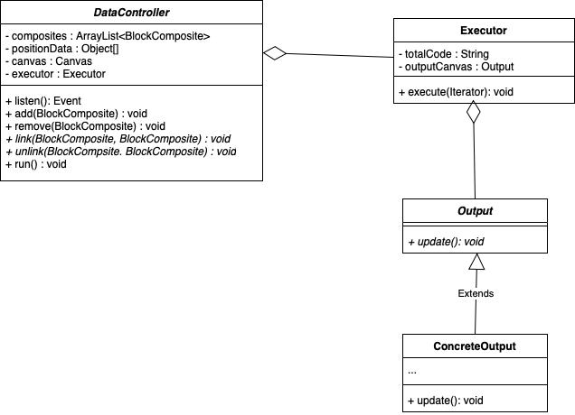
Output
Executor pieces program together
Sends off to external compiler
Retrieves output from compiler
Abstract for developer customization
Notes:
Dana
Subsystem initiated by the DataController (run function)
External compiler will run program
Output displayed on the OutputCanvas
Left abstract for developer to decide (mention some graphical outputs seen commonly in VPLs and how theyre all different)
Scratch vs flowgrithm

Slide 15
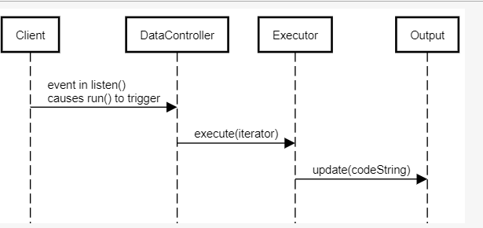
Sequence Diagram - Running a program
Notes:
Dana
Sequence diagram called for running a program
listen() in DataController leads to event where run() is called
run() calls executor that uses the iterator to traverse the blocks
The final program (saved as a string in Executor) is sent to the external compiler
Output is returned and displayed

Slide 16
Developer Example
As a developer using this framework, what do I need to implement?
Visual component
Data controller
Output view
Client
Notes:
As far as with what the developer needs to implement, concrete visual component , data controller and outputView classes need to be created.
Once that is done, code can be implemented in the client for the VPL environment to be ran by an end-user.

Slide 17
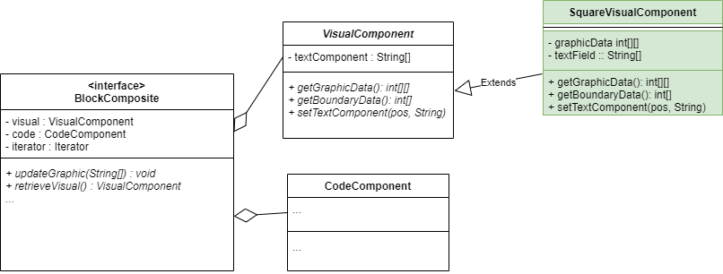
Creating the Concrete Visual Component
Notes:
Michael
The VisualComponenet is a part of the BlockComposite subclass and needs to be implemented as a concrrete version. A simple implementation of a concrete visual Component would hold a default array that is like a square with empty text fields. The set text component function will change the graphical data based on the string and pos The getGraphicData will simply return the array.

Slide 18
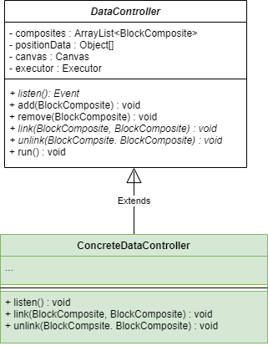
Creating the Concrete Data Controller
Pseudo code for Blocks in listen():
CodeComponent whileCode = new CodeComponent(code,1)
Block whileBlock = new Block(whileCode, new ConcreteVisualComponent)
CodeComponent varCode = new CodeComponent(code,1)
Statement varAssign= new Statement(varCode, new VarVisualComponent)
Notes:
listen()
Pseudo would be implemented in listen
Code block component is initialized and a permanent section of available blocks is painted to the side
The listen function would handle any user interaction such as drag and drop new code blocks
Deleting blocks and moving blocks. These would happen by the respective add, remove , link , and unlink functions being called
link()
Called in listen , puting one composite inside another composite
unlink()
Undoing links, taking the composite out of the other. Putting into the composites array

Slide 19
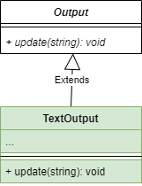
Creating the Concrete Output
Notes:
Michael
The ConcreteOutput has a textOutput field as a string. When update() is called, this string is printed to an output terminal. ConcreteOutput also has a close function that cleans up the memory and terminates the program.

Slide 20
Implementation in Client
Canvas canvas = new Canvas();
ConcreteOutput output = new ConcreteOutput();
Executor executor = new Executor(output);
ConcreteDataController controller = new ConcreteDataController(canvas,executor);
controller.listen();
Notes:
Michael
The client must initialize the Canvas and the Executor. The Canvas and Executor are passed to initialize a ConcreteDataController. Then listen is called on dataController.

